Slide 1

ALGORITHMS FOR IMPLEMENTING COLLECTIVE OPERATIONS IN THE REMOTE MEMORY ACCESS MODEL FOR DISTRIBUTED COMPUTING SYSTEMS Program Computer Science and Knowledge Discovery
student :Mohamed Abuelsoud
Group 7300
Supervisor Alexy Paznikov

Slide 2
Parallel hardware architectures
Node 1
Node
Node
CPU
CPU
CPU
CPU
CPU
CPU
CPU
CPU
CPU
CPU
CPU
CPU
Data bus
Data bus
Data bus
Memory
Memory
Memory
node-interconnect
Cluster
Node
fast access only on its own memory
Many programming options:
Shared memory / symmetric multiprocessing inside of each node
distributed memory parallelization on the node interconnect
Or simply one MPI process on each core
ccNUMA (cache-coherent non-uniform memory access)
Shared memory programming is possible
Each parallel execution stream should mainly access the memory of its CPU
First-touch strategy is needed to minimize remote memory access
Threads should be pinned to the physical sockets
Notes:
The hardware architecture of parallel computing is distributed along the following categories as given below
Single-instruction, single-data (SISD) systems
Single-instruction, multiple-data (SIMD) systems
Multiple-instruction, single-data (MISD) systems
Multiple-instruction, multiple-data (MIMD) systems

Slide 3
Message-Passing Interface (MPI)
Design an application programming interface (not necessarily for compilers or a system implementation library).
MPI addresses primarily the message-passing parallel programming model, in which data is moved from the address space of one process to that of another process through cooperative operations on each process
Allow efficient communication: Avoid memory-to-memory copying, allow overlap of computation and communication, and offload to communication co-processors, where available
Define an interface that can be implemented on many vendor’s platforms, with no significant changes in the underlying communication and system software.
message-passing model are provided in collective operations, remote-memoryaccess operations, dynamic process creation, and parallel I/O
Notes:
MPI (Message-Passing Interface) is a message-passing library interface specification. All parts of this definition are significant. MPI addresses primarily the message-passing parallel programming model, in which data is moved from the address space of one process to that of another process through cooperative operations on each process. Extensions to the “classical” message-passing model are provided in collective operations, remote-memory access operations, dynamic process creation, and parallel I/O. MPI is a specification, not an implementation; there are multiple implementations of MPI. This specification is for a library interface; MPI is not a language, and all

Slide 4
Advantages
Reduce synchronization
No delay in sending data
Functionality and scalability
Comparison p2p &RMA
Point to Point communication
One Sided communication
Process 0
Process 1
Process 0
Process 1
send
recv
Put
get
Local snd_buf
Local rcv_buf
Local snd_buf
Local rcv_buf
Memory
Memory
Memory
window
Memory
window
With a collective MPI_Win_create()
each process
provides memory portion (=window) that is now accessible from outside put,get
Notes:
Advantages
Reduce synchronization. There is some implicit synchronisation involved in two-sided communication. For instance, a receive operation cannot finish before the associated send has begun. This that synchronisation is required for each and every data transmission. One synchronisation step may be used to accomplish many separate PUT and GET operations using one-sided communication.
No delay in sending data. PUTs and GETs are non-blocking operations. For instance, this implies that a distant process may go on with its work while another process sends it data rather than having to wait for it.
Functionality and scalability You can overcome several issues while employing onesided communication and scalable programs.The amount of time needed for two-sided conversation is much more.
Functionality and scalability. You can overcome several issues while employing onesided communication and scalable programmes.The amount of time needed for twosided conversation is much mor

Slide 5
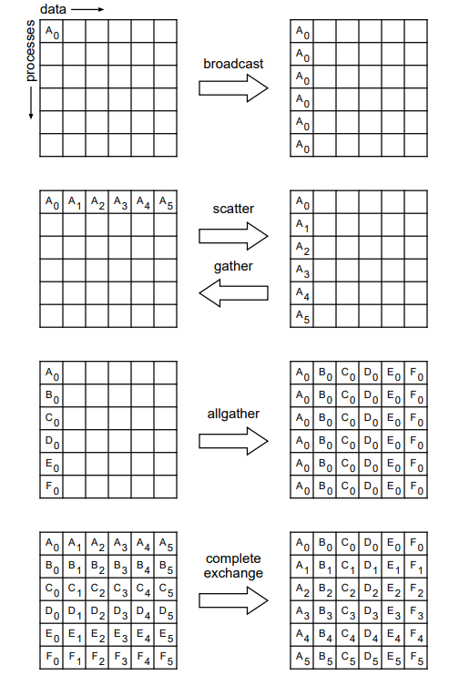
COLLECTIVE OPERATIONS
For each collective operation, defined in MPI as a series of point-to-point transmissions between the relevant processes, a collective component called Tuned, for example, implements different algorithms. A communicator gives the collection of processes carrying out the collective activity an isolated communication context. Procedures in a communicator include a root integer number starting at 0
Notes:
MPI_GATHER implements an all-to-one gather operation:All processes transfer data from inbufffer to root, including the root process. Data from process i is placed before data from process i+1 in continuous, nonoverlapping areas in the outbuffer throughout this process. Because there are P processes involved in the operation, the outbuffer in the root process must be P times larger than the inbuffer. Other than the root process, the outbuffer is not taken into account.
MPI_SCATTER implements a one-to-all scatter operation:It is MPI_GATHER’s opposite. Each process gets data from root in outbuffer, while a defined root process provides data to all processes by sending the i th part of its inbufffer to process i. Therefore, the root process’s inbufffer and outbuffer must be P times larger than one another. The slight distinction between this function and MPI_BCAST is as follows: Every process gets the same value from the root process in MPI_BCAST, but in MPI_SCATTER, each process receives a unique value.
MPI broadcast semantics, only the root is allowed to change the broadcast data. A local pointer to the start of this shared memory area allows any process on the same node to independently access the broadcast data. Since the size of the broadcast message is the same as that of the pure MPI broadcast, conducting the across-node broadcast operation (across all the leaders)

Slide 6
RMA Broadcast vs MPI Broadcast
root
root
Matching tag and specify source
put
send
1
2
3
1
2
3
receive
receive
receive

Slide 7
Broadcast
algorithms organizing processes in various tree structures: balanced k-ar trees, flat trees , pipelines (k-chains)
Binomial Tree
Binary Tree
Round
Round
1
0
1
0
1
1
2
2
0
1
2
3
4
5
6
2
3
0
3
7
4
2
1
6
3
5
7
Notes:
Binomial
At the first round on Figure 4.3 P0 sends message to P1 and at the second round P0 send to P1 and P2 .Finally, at the third round P0 sends messages to P1 ,P2 and P4 in addition to that P1 sends messages to P3 and P5 also P2 sends message toP6 and finally P6 send message to P7 [1, 29]. With each round being shown a doubling of the number of nodes broadcasting and receiving. As a result, there are fewer transmission stages from P − 1 to log2(P) and can be calculated
There are two fundamental drawbacks of broadcasting down a binomial tree. First, when the communicator size is not a correct power of two, the communication time is obviously out of balance [29].To finish the task, the final step (for instance, rank 7 in Figure 4.3) requires log2(P) communication rounds.
Binary Tree
At the first round in Figure 4.4 P0 sends a message to P1 and P2 , at the second round P1 sends to P3 and P4 , for the third round P2 sends messages to P5 and P6 .Finally, at the Fourth round, P3 sends messages to P7 [28]. The height of the binary tree is equal to total=T*log2(p)

Slide 8
Binomial Algorithm
Calculate based of the rank that relative to the root
srank = (my_rank − root + p)%p
mask = 1 ;
while mask < p do
if (srank&mask) == 0 then
put_rank = srank|mask
if put_rank < p then
put_rank = (srank + root)%p
check_received_data
move_data(snd_buf,rcv_buf,
rank, win)
else
break
end if
mask = mask << 1
end if
end while
For each unset bit in the relative rank
binary representation
Compute Put rank process with the bit set to which the current process is sending data
Reverse transformation from relative rank
to original
MPI_Win_lock(MPI_LOCK_SHARED, win)
for i = 0 to sizeof(snd_buf) do
rcv_buf[i + rank] = snd_buf[i]
end for
MPI_Win_sync(win)
MPI_Win_unlock(rank, win)

Slide 9
L ----buffer length
srank ----shifted rank
prank ----put rank
Root(Round x)
x ----round number
0000
srank = (my_rank − root + p)%p
mask = 1 ;
while mask < p do
if (srank&mask) == 0 then
put_rank = srank|mask
if put_rank < p then
put_rank = (srank + root)%p
check_received_data
move_data(snd_buf, rcv_buf, rank, win)
else
break
end if
mask = mask << 1
end if
end while
0
L
srank
prank
0 (Round 3)
0 (Round 1)
0 (Round 2)
0001
0010
0100
0
L
0
L
0
L
srank
prank
1 (Round 3)
srank
prank
1 (Round 3)
2 (Round 3)
0011
0101
0110
v
0
L
0
L
0
L
srank
prank
6 (Round 3)
0111
0
L

Slide 10
Usage
descr_t descr;
descr.root = 0;
int provided = MPI_THREAD_MULTIPLE;
int *rcv_buf;
int snd_buf = std::stoi(std::string(argv[1]));
MPI_Win win;
MPI_Comm comm_sm;
MPI_Init_thread(&argc, &argv, MPI_THREAD_MULTIPLE, &provided);
MPI_Comm_rank(MPI_COMM_WORLD, &my_rank);
MPI_Comm_size(MPI_COMM_WORLD, &size);
MPI_Win_allocate_shared((MPI_Aint)max_length * sizeof(int), sizeof(int),
MPI_INFO_NULL, comm_sm, &rcv_buf, &win);
if (my_rank != 0)
{
MPI_Win_shared_query(win, 0, &buf_size, &disp_unit, &rcv_buf);
}
if (my_rank == 0)
{
if (bcast_type == binomial)
RMA_Bcast_binomial((buf_dtype *)snd_buf, rcv_buf, my_rank, descr, size, win, comm_sm);
else if (bcast_type == linear)
RMA_Bcast_Linear((buf_dtype *)snd_buf, MPI_FLOAT, buf_size, descr, size, win, comm_sm);
else if (bcast_type == binary)
BinaryTreeBcast((buf_dtype *)snd_buf, rcv_buf, my_rank, descr, size, win, comm_sm);
MPI_Win_flush(my_rank, win);
}else{MPI_Win_flush(my_rank, win);}
MPI_Win_free(&win);
MPI_Finalize();

Slide 11
Evaluation
Information and Computing Center of Novosibirsk State University
Cluster 1:
HP XL230a Gen9 Two 12-core Intel Xeon E5-2680v3 processors with a clock frequency of 2500 MHz.
Cluster 2:
HP XL250a Gen9 Two 12-core Intel Xeon E5-2680v3 processors @ 2500 MHz
Two Intel Xeon Phi 7120P co-processors each with:
16 GB native RAM
61 cores running in 244 threads at 1.2 - 1.3 GHz
1.2 teraflops of peak performance
Micro benchmark tests were constructed to simulate realistic computational loads that are representative of our research scenarios.
We subjected the server to tests involving 1,000 messages
spread across eight different data packets.The packet sizes varied in a binary progression,
Starting from a minimum size of 16 bytes and doubling sequentially until reaching a maximum size of 33,554,432 bytes (or 33 MB)
Number of processes p=4,8,16…40

Slide 12
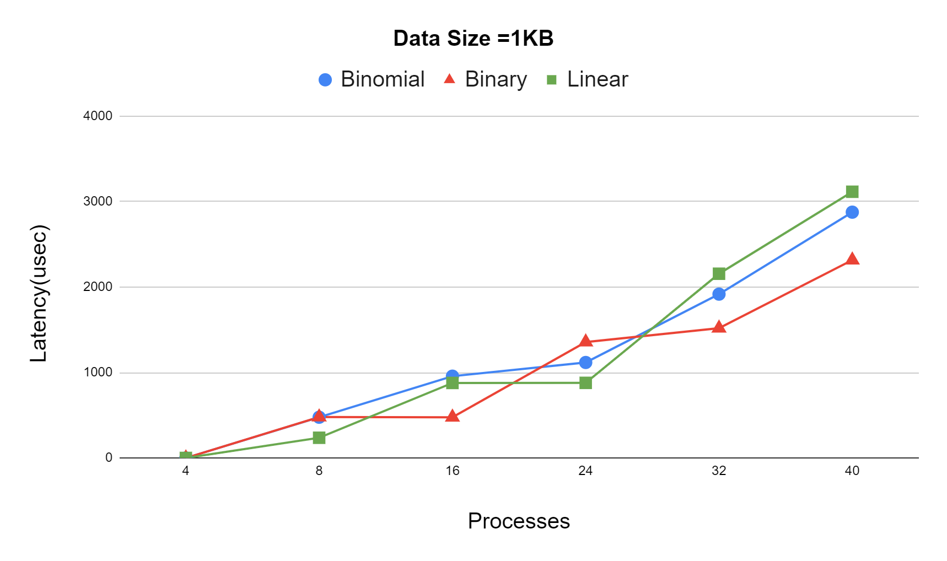
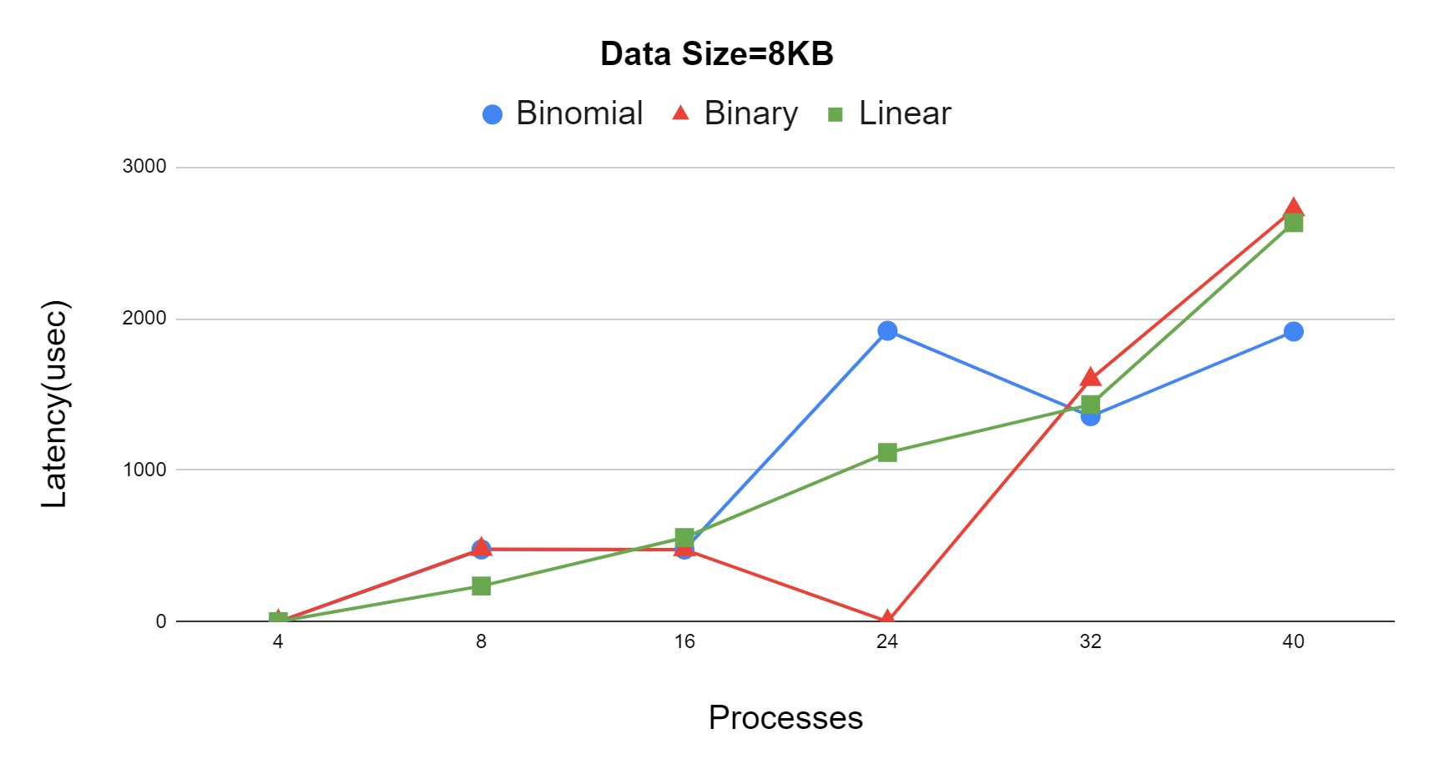
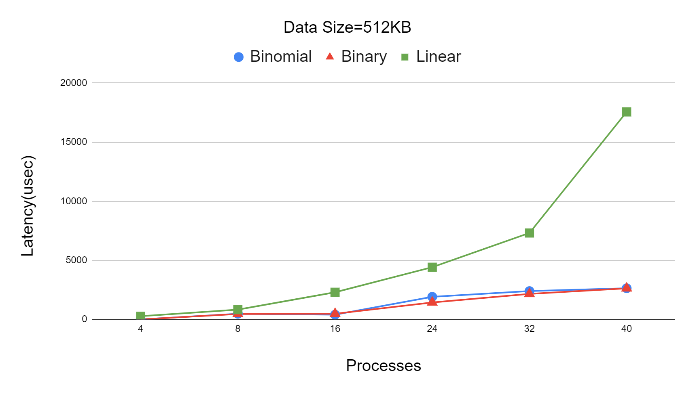
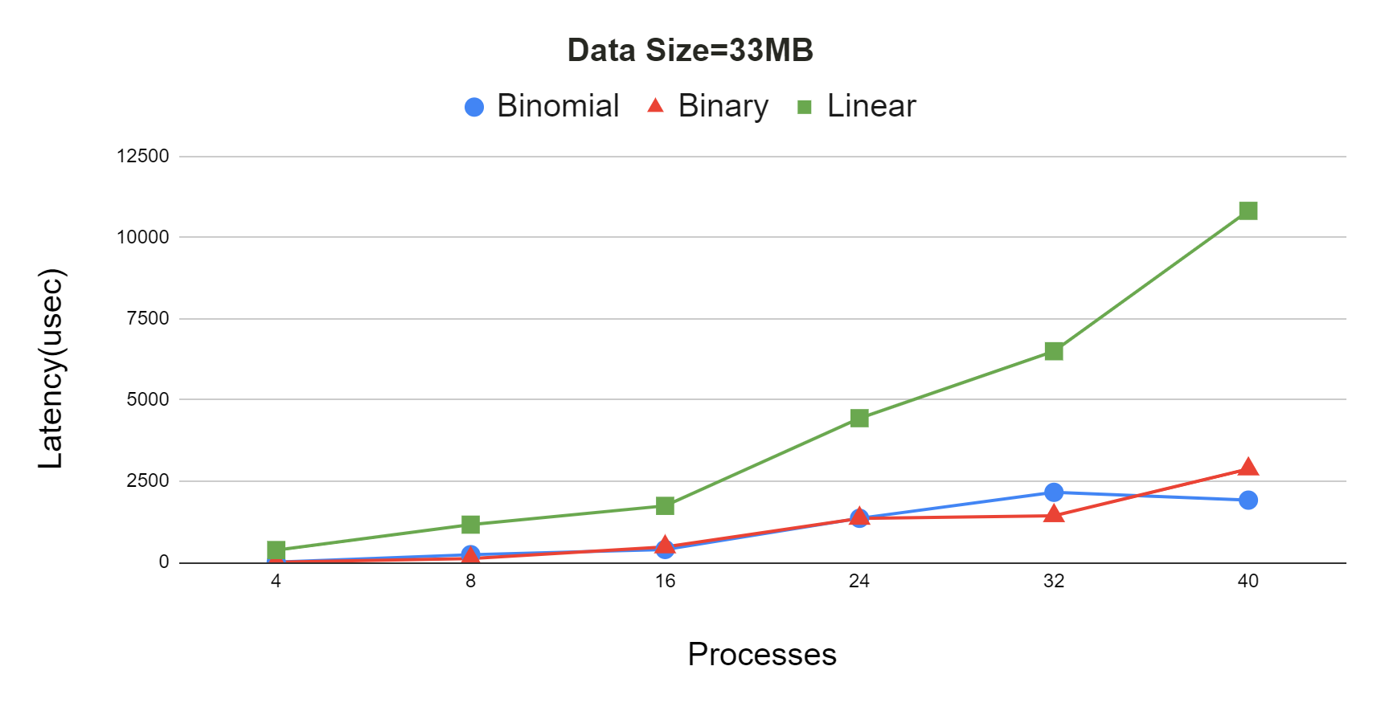
Latency Benchmark

Slide 13
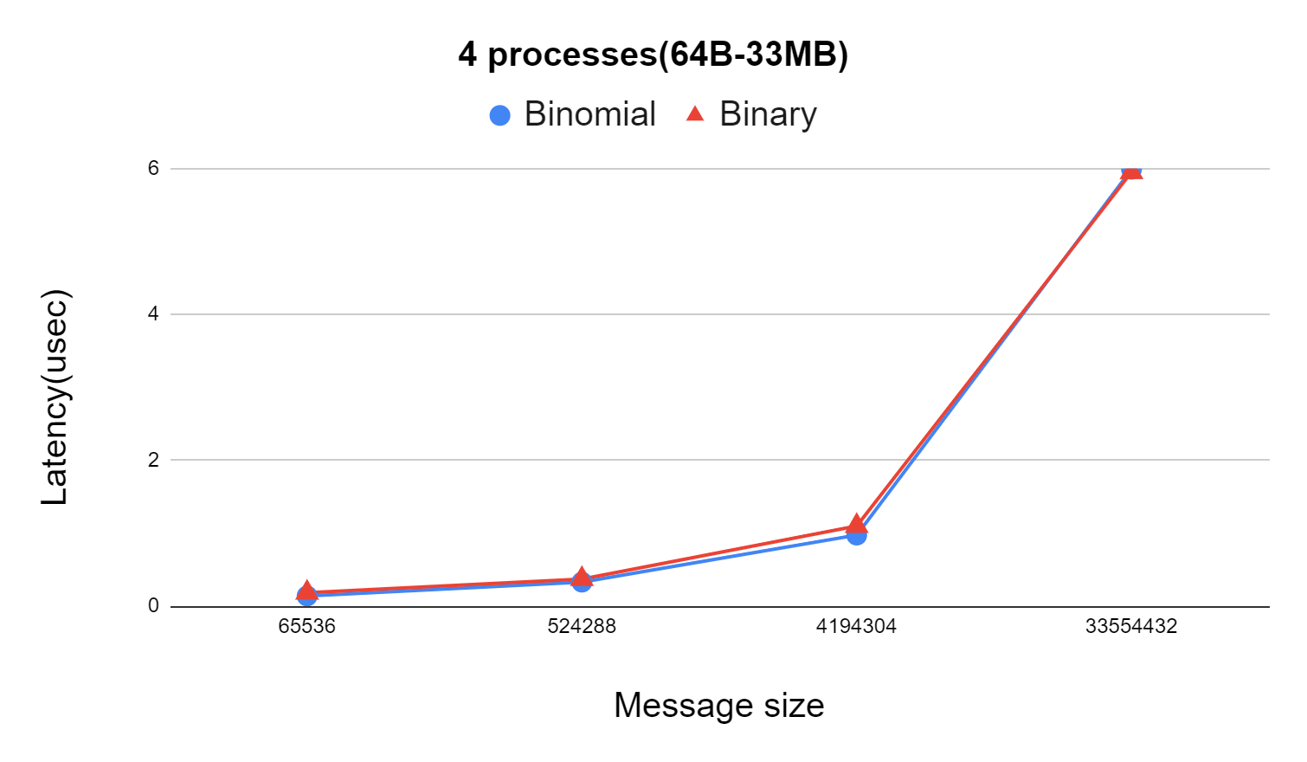
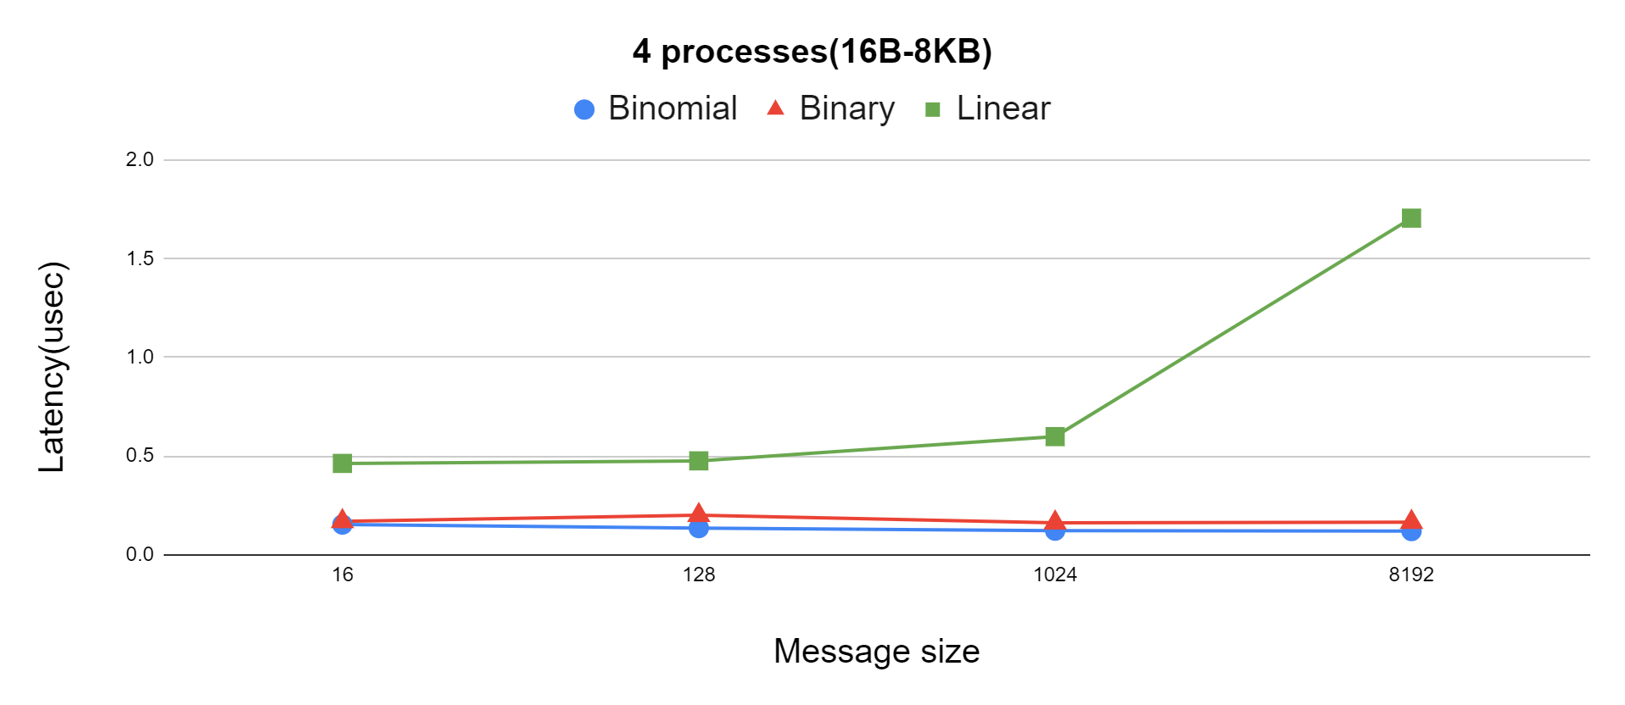
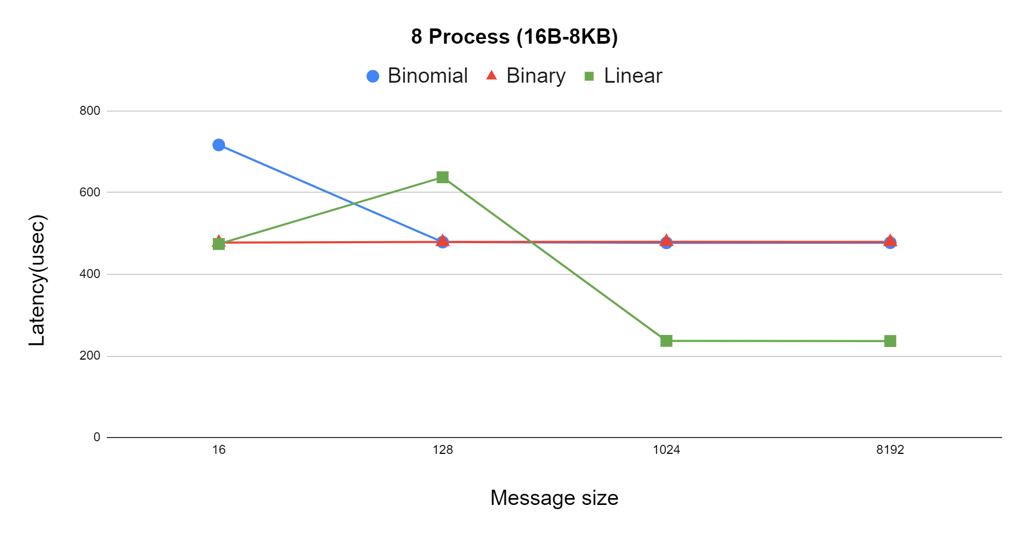
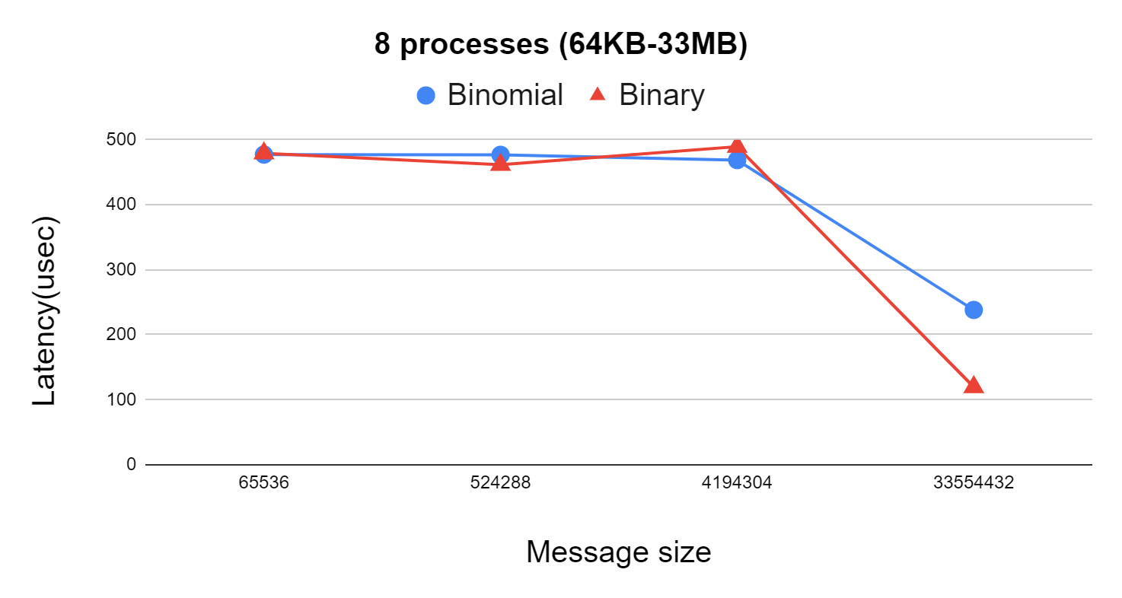
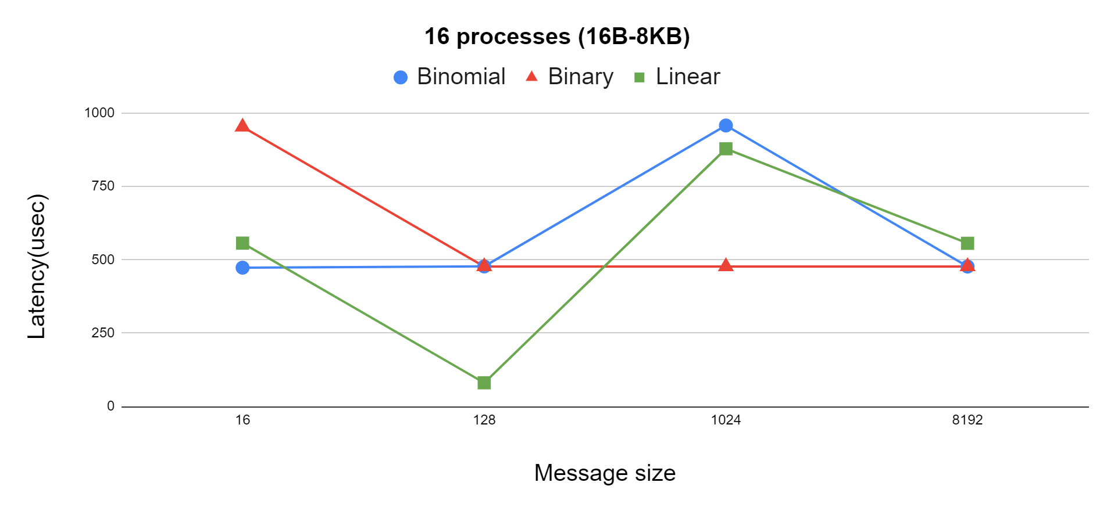
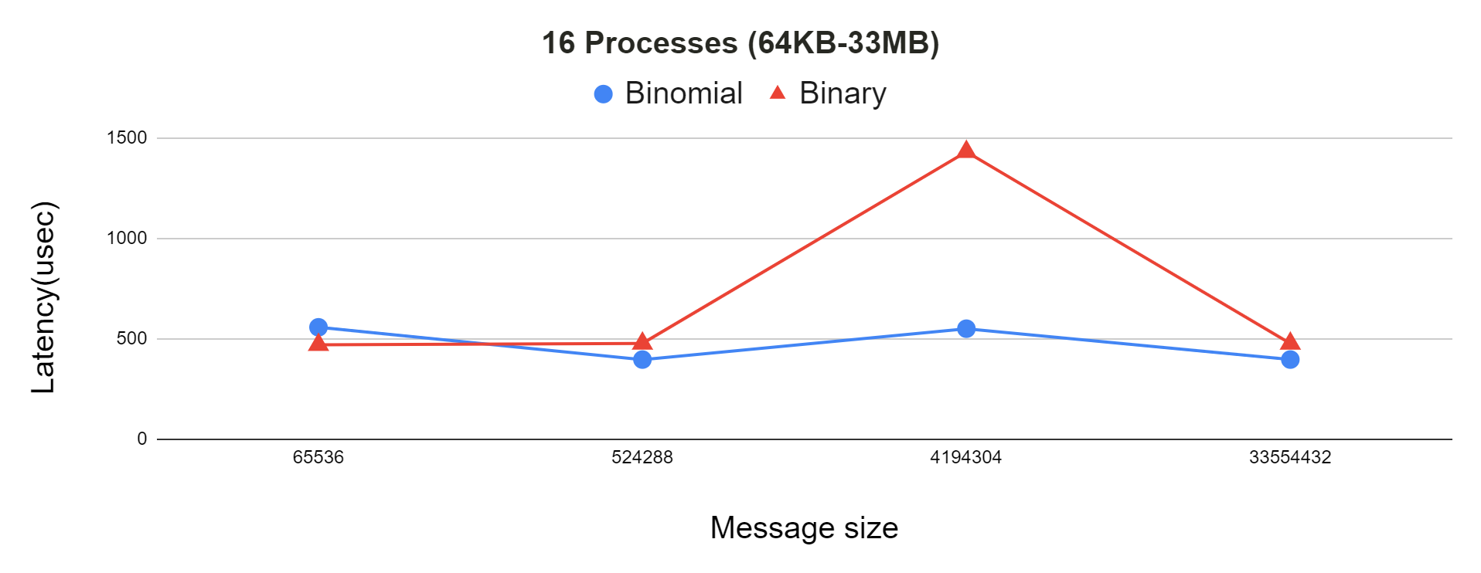
Latency Benchmark 2

Slide 14
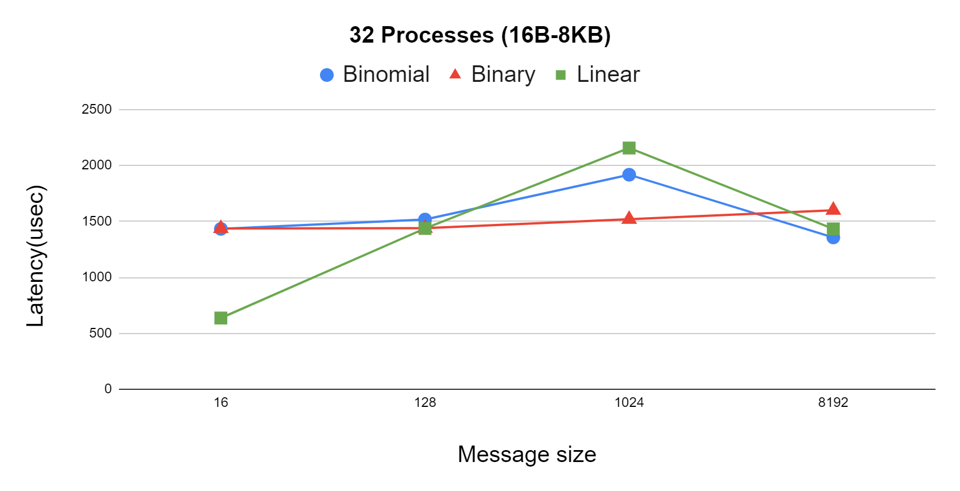
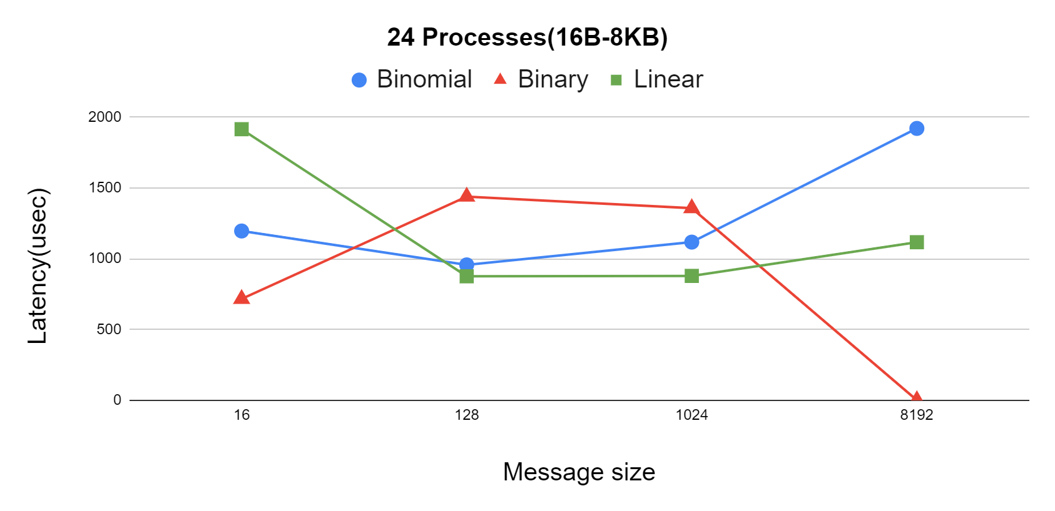
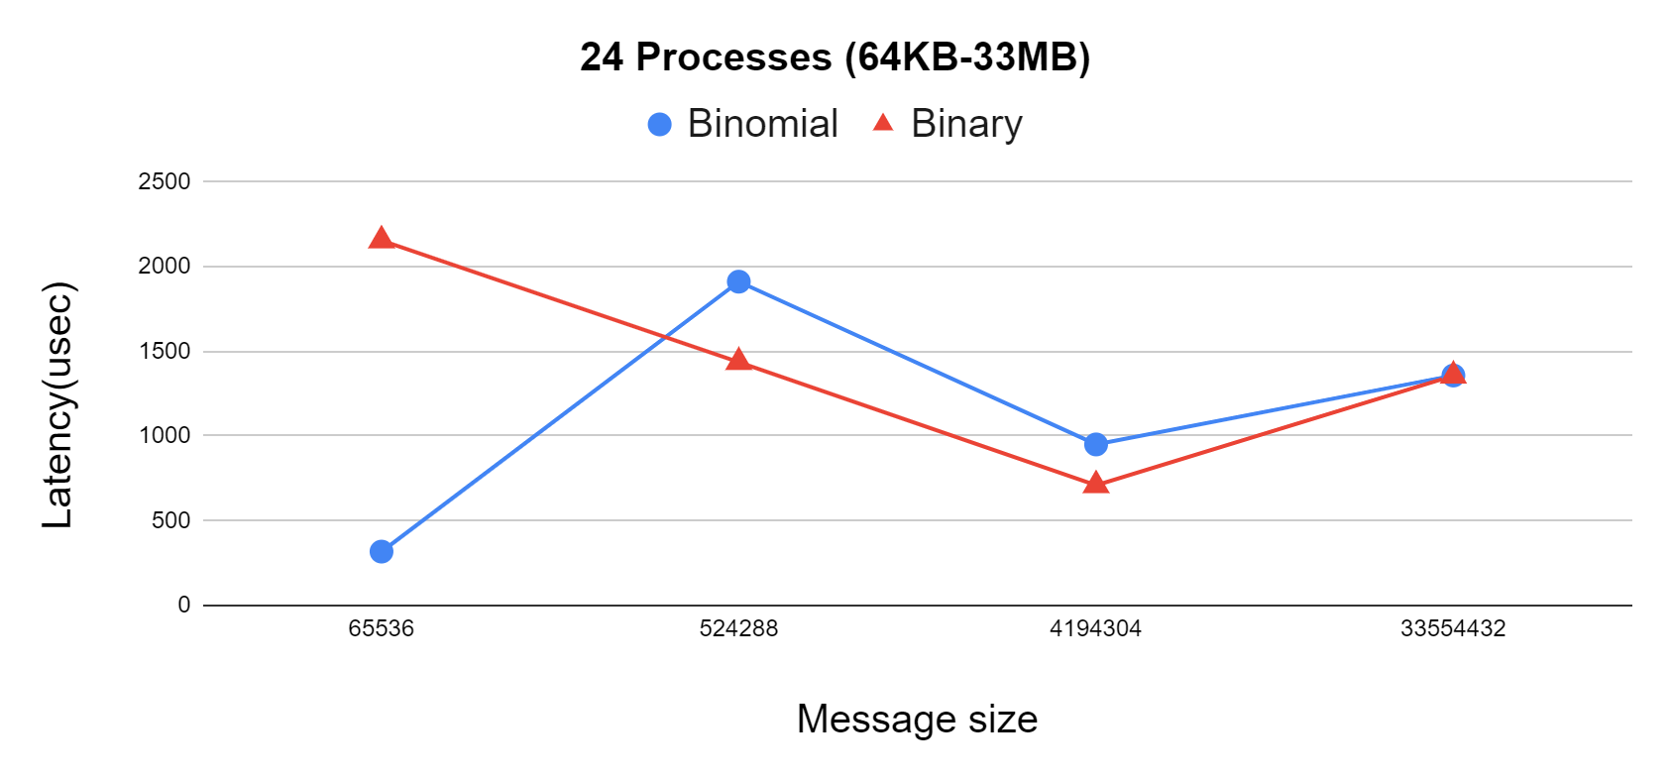
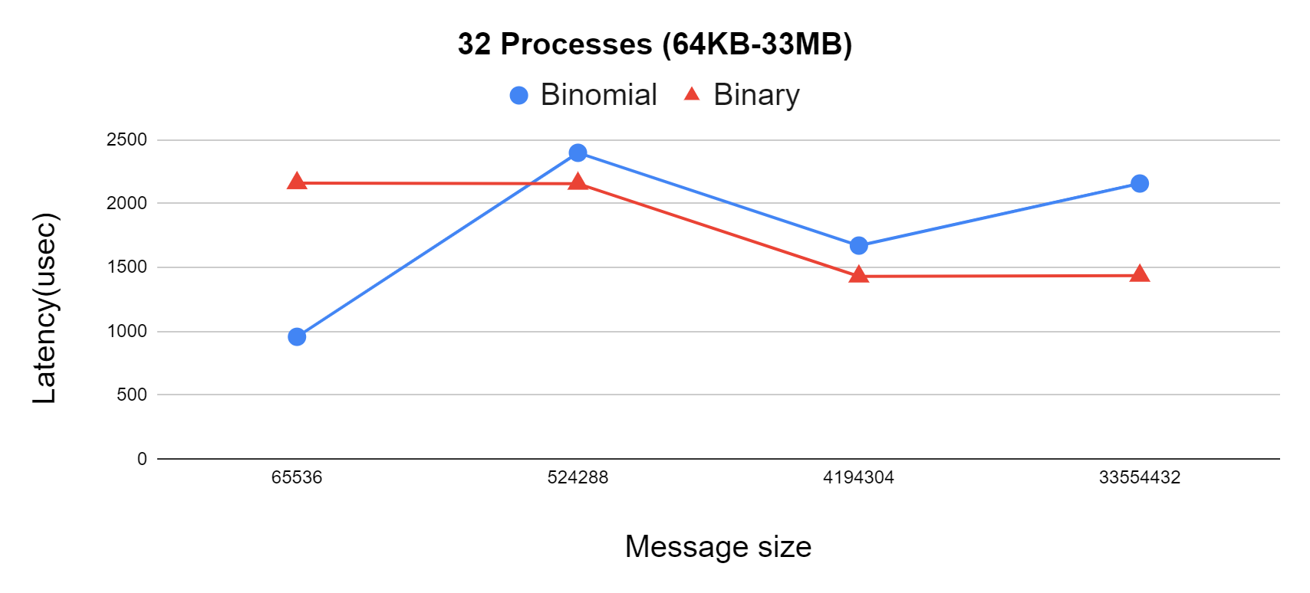
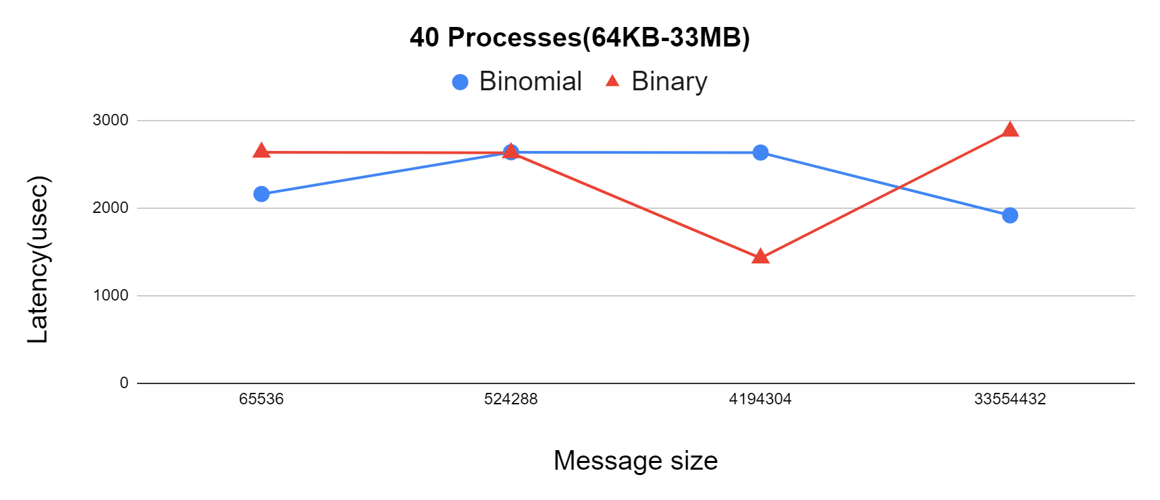
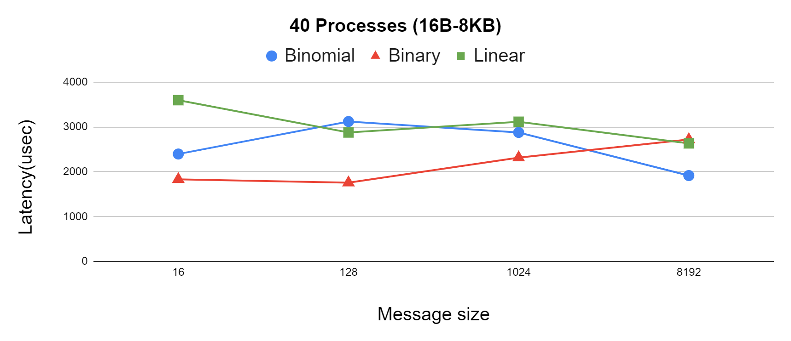
Latency Benchmark 3

Slide 15
Conclusion
we designed the Binomial tree algorithm for RMA Broadcast operations. By leveraging shared memory,
Our findings suggest that the proposed RMA broadcast approach of RMA Shared memory for both Binomial tree and Binary tree algorithms is effective
for larger messages up to 33 MB, the Binomial and Binary trees were the fastest algorithms. As the number of processes and data sizes increase, the Binomial tree algorithm with the shared memory approach is strongly recommended.
The Linear tree algorithm demonstrated superior speed for data volumes ranging from 16 Bytes to 65KB, particularly for a smaller number of processes (fewer than 32)

Slide 16

Thank you for Listening
Any questions

